Slide 1
Demonstrating ABMI bird models being used in ALCES Online
Lionel Leston
Fri May 29, 2020 1pm - 2pm (MDT)

Slide 2
ABMI Bird GLMs
Model coefficients generated from 240 bootstrap runs of the model
Median values of model coefficients were used to minimize influence of extreme coefficient values
Variables included:
Local land cover type (Vegetation, human footprint)
Weighted-averaged forest age
Stand-scale cover types (Vegetation, human footprint)
Stand-scale amount of preferred habitat for each species
Latitude, Longitude
Climate variables

Slide 3
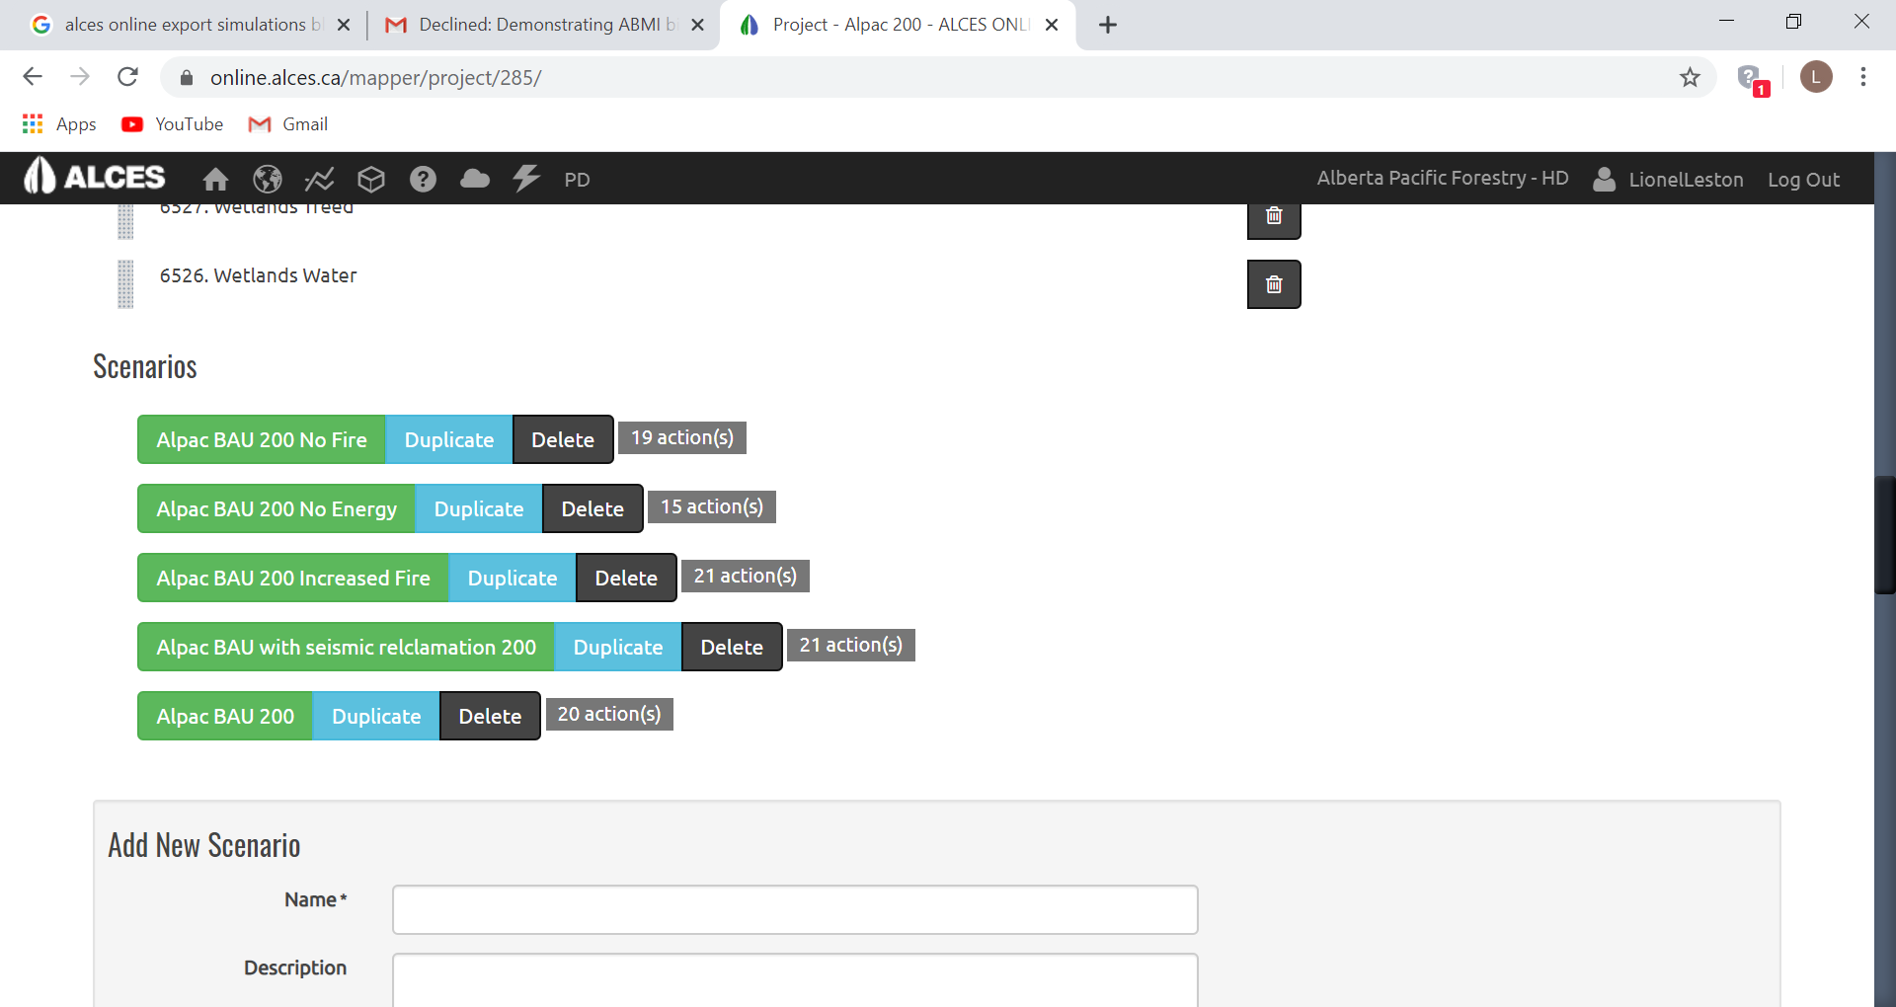
Five Scenarios run in ALCES Online, constructed in Mapper

Slide 4
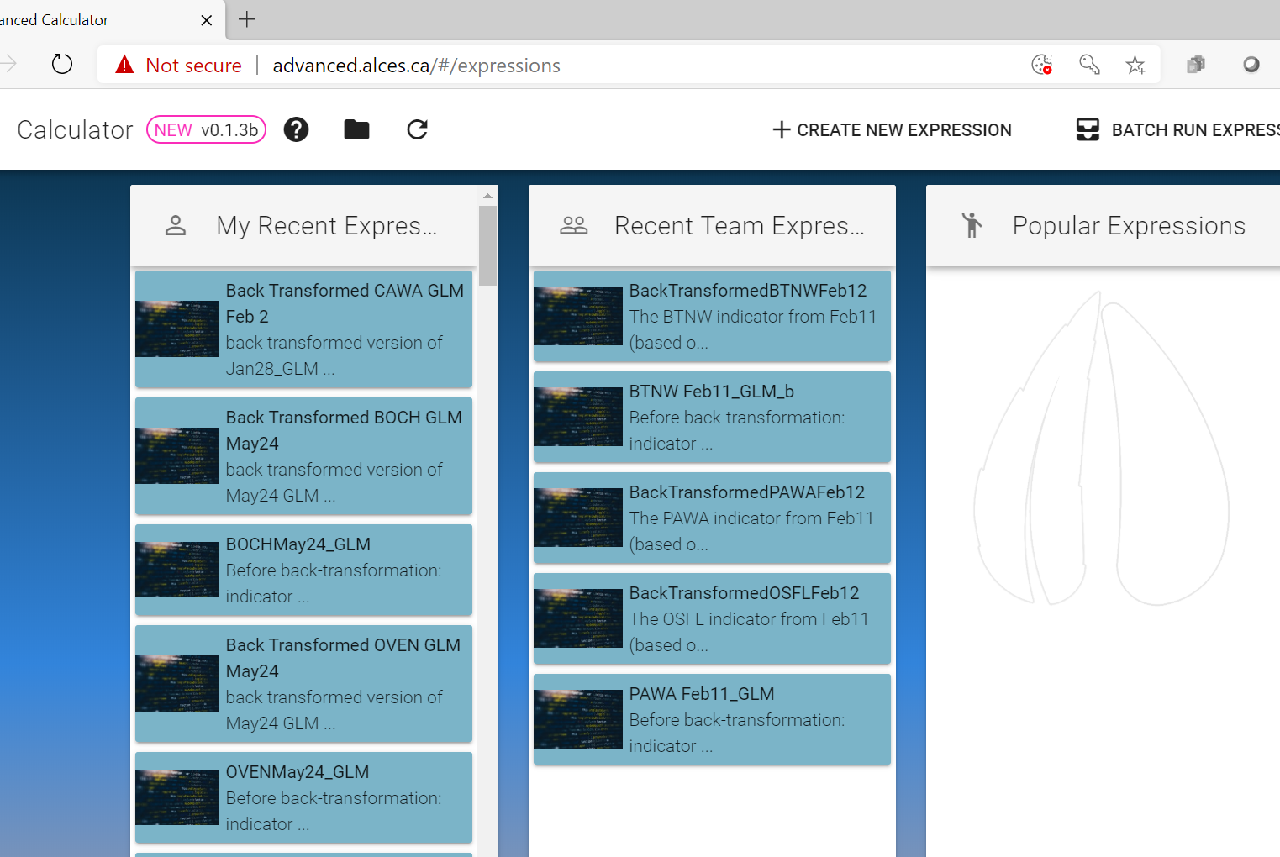
Species indicators constructed in ALCES Advanced Calculator (or in Map)

Slide 5
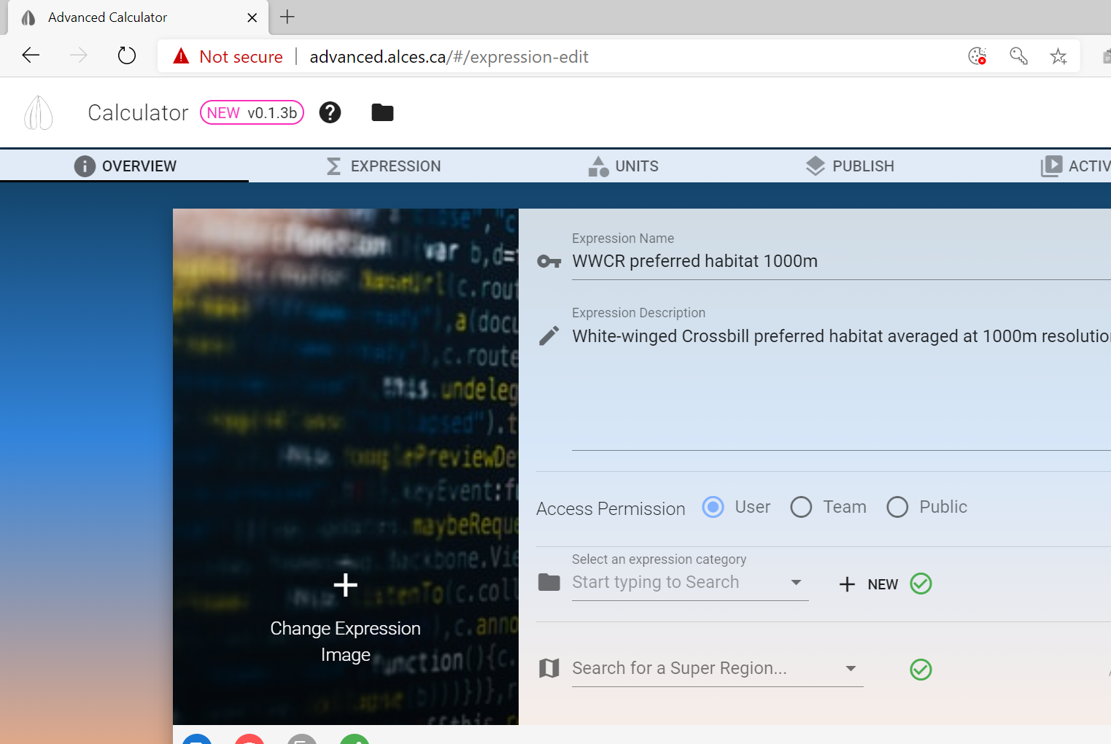
Each species indicator included simpler indicators previously run in ALCES Online

Slide 6
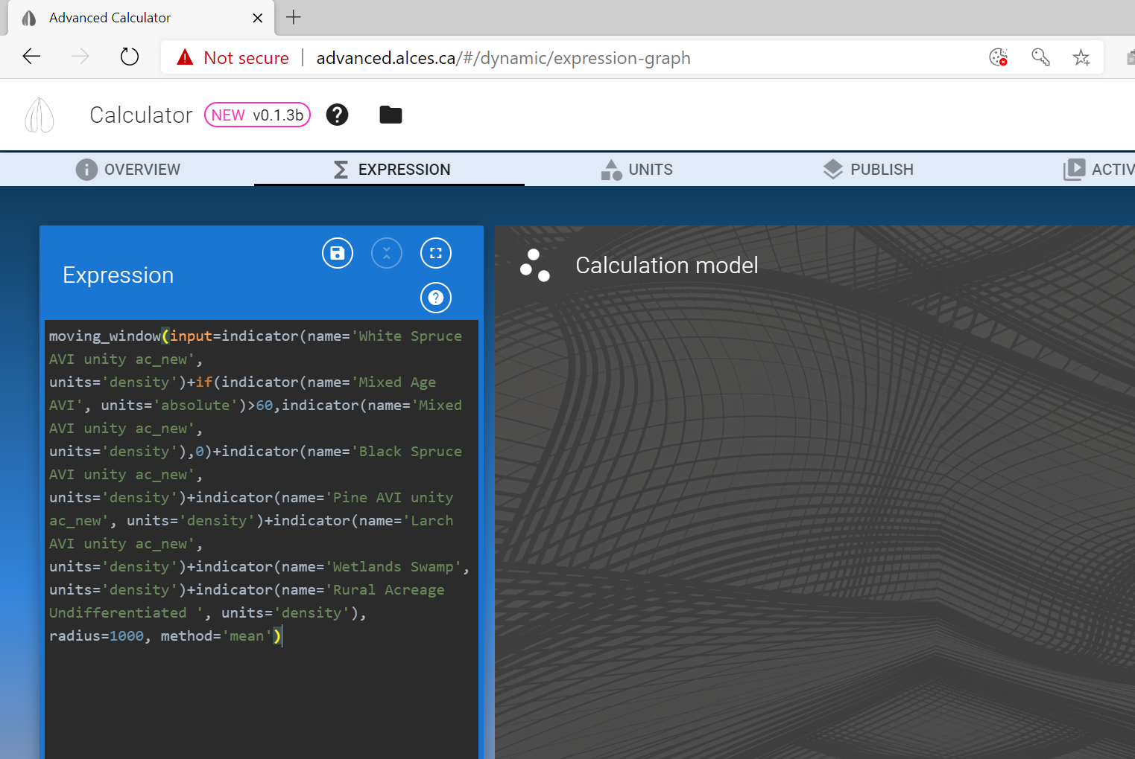
Indicators are constructed as expressions using functions (e.g. moving window) and model coefficients (linked to existing raster layers in ALCES Online)

Slide 7
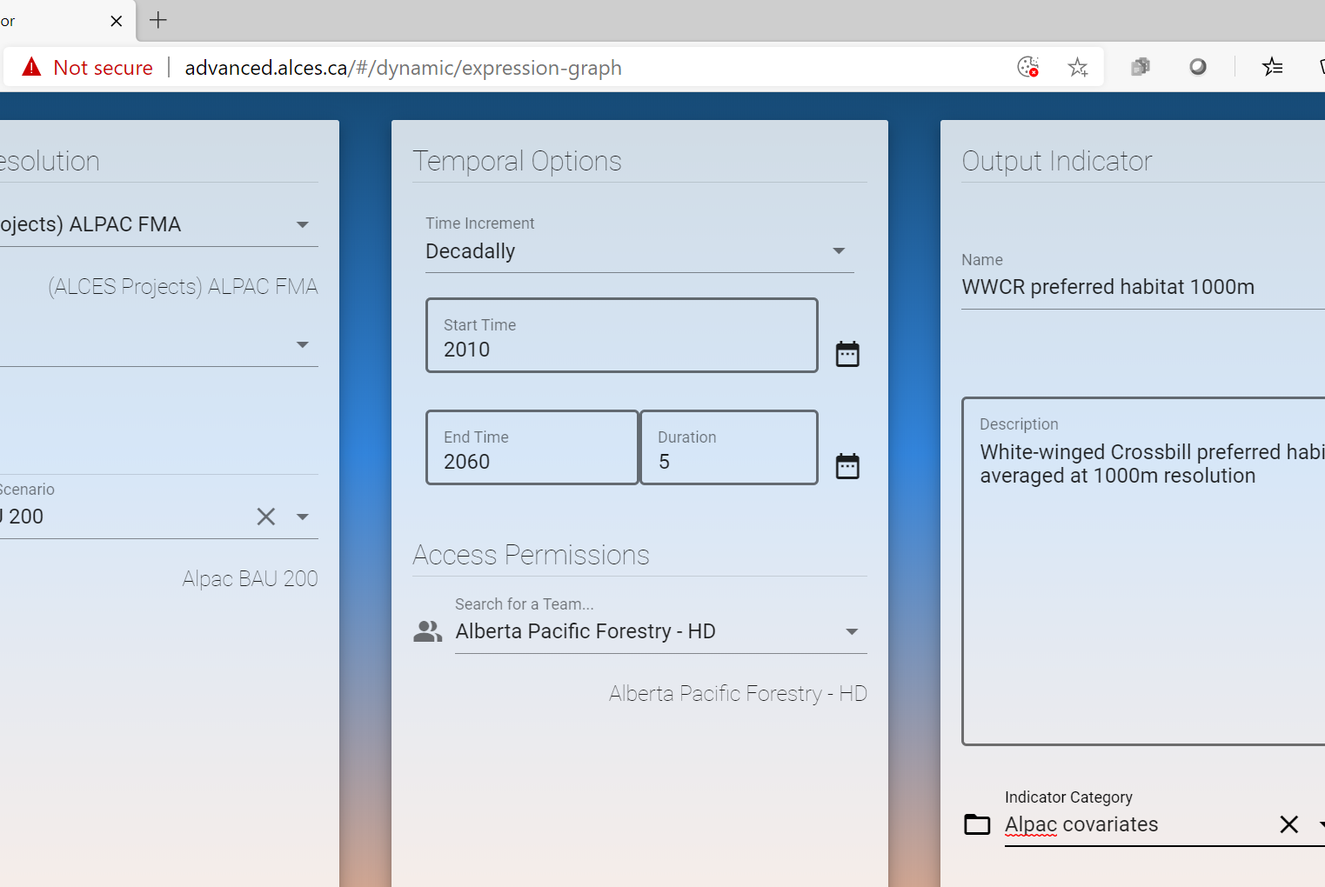
Once constructed, each simpler or more complex indicator must be run through land use scenarios and “published” to ALCES Online

Slide 8
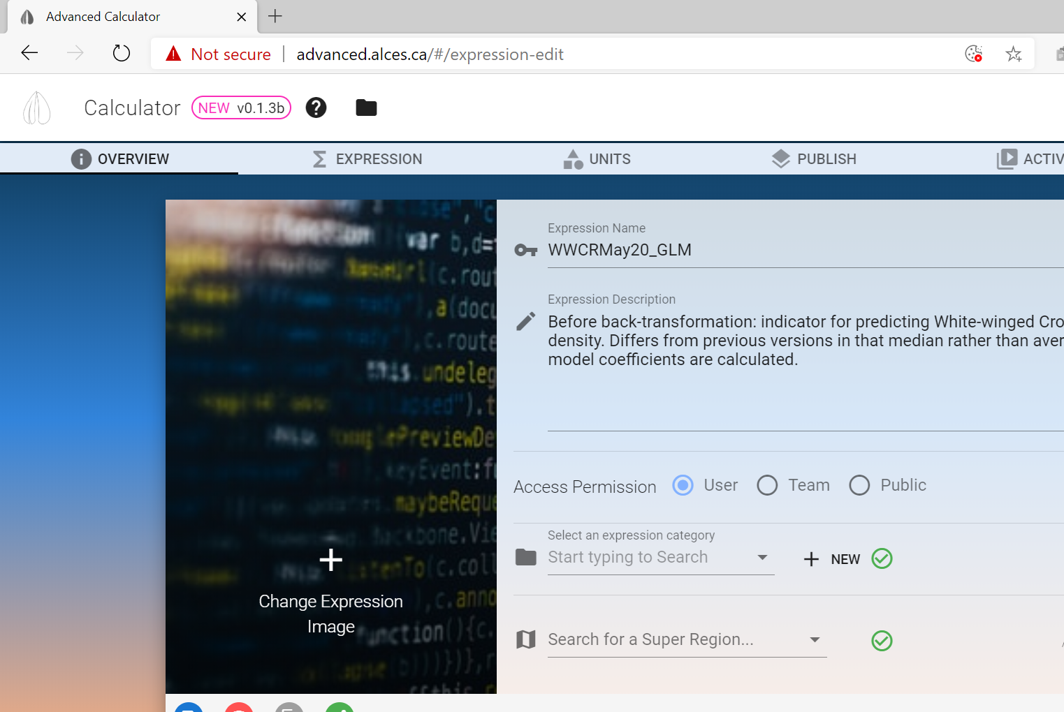
For complex indicators such as actual bird species, “simpler” complex indicators like “preferred habitat” should be run and published first.

Slide 9
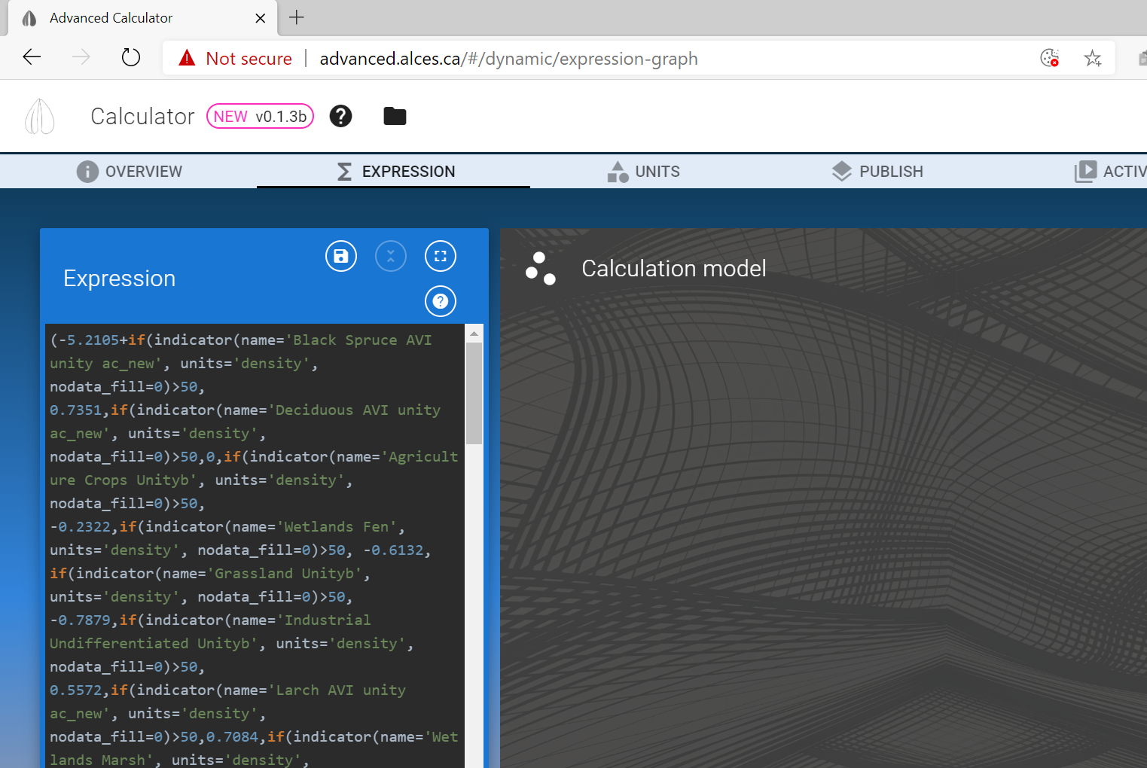
There can be up to a few dozen variables in each species indicator.

Slide 10
I complete a full indicator formula, then copy it to MS Word and change the coefficients for other species. I then create an abbreviated indicator formula where variables with coefficient=0 are removed, and use that formula in other species indicators.

Slide 11

Original bird models were Poisson GLMs. Predictions from species indicators are based on the linear predictor of bird model coefficients. One more step needed: to back-transform (take the antilog of) the linear predictions to get predicted density (#males/ha)

Slide 12
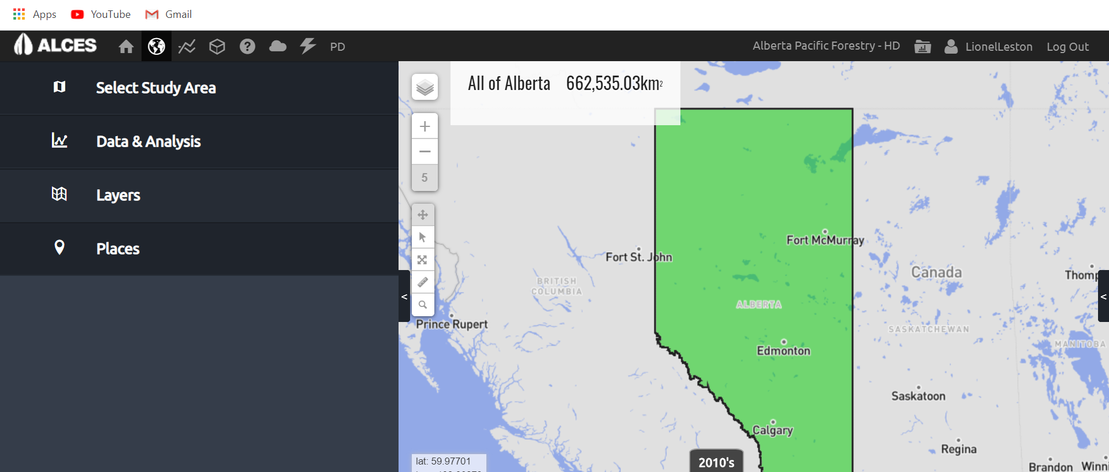
Once indicator has been published, predictions can be viewed in “Map” component of ALCES Online

Slide 13
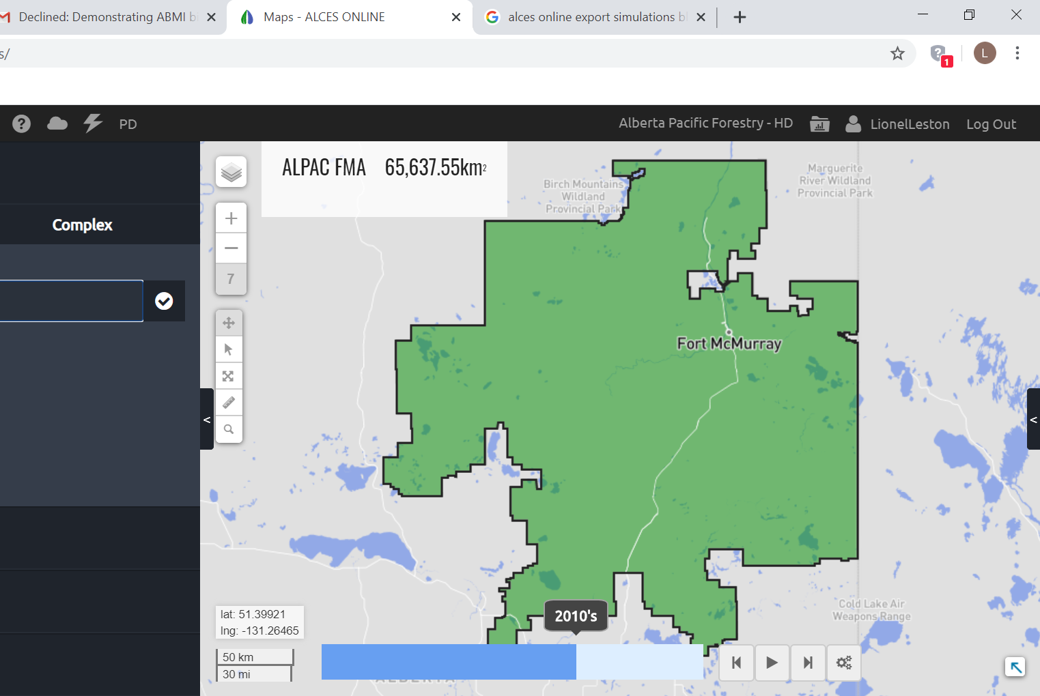
I pick a study area

Slide 14
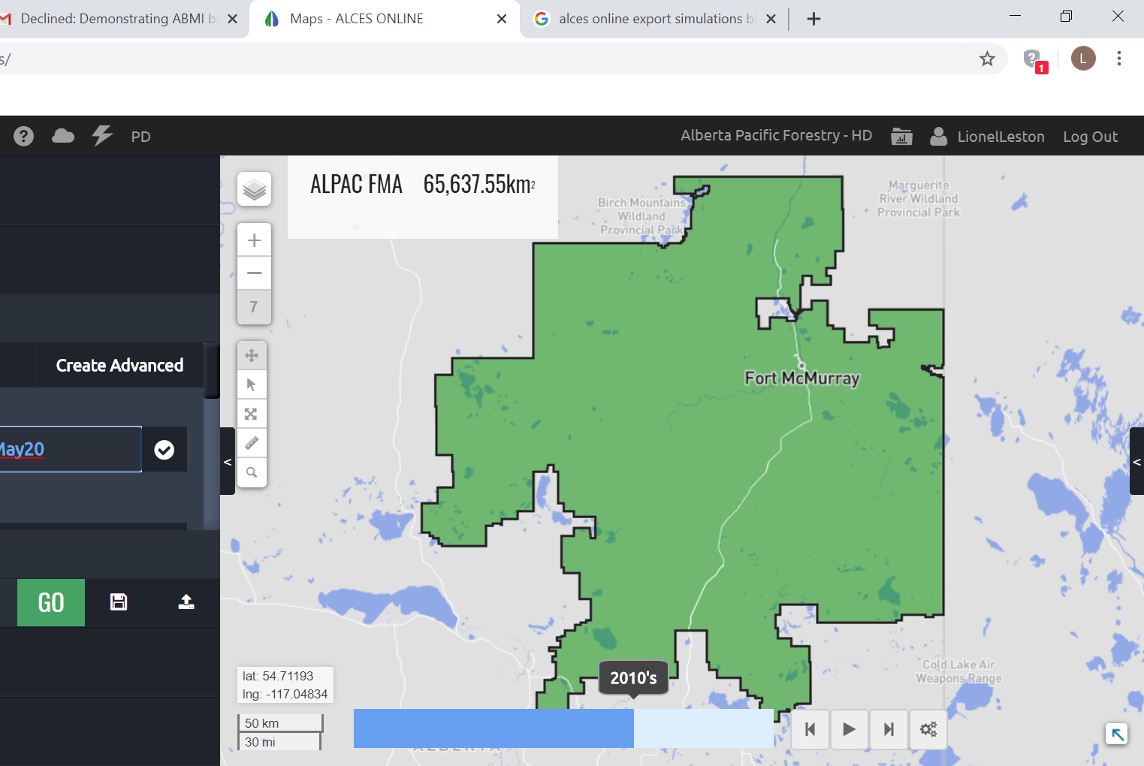
I pick an indicator

Slide 15

I pick a land use scenario and resolution I want to run at (e.g. 200 m)

Slide 16
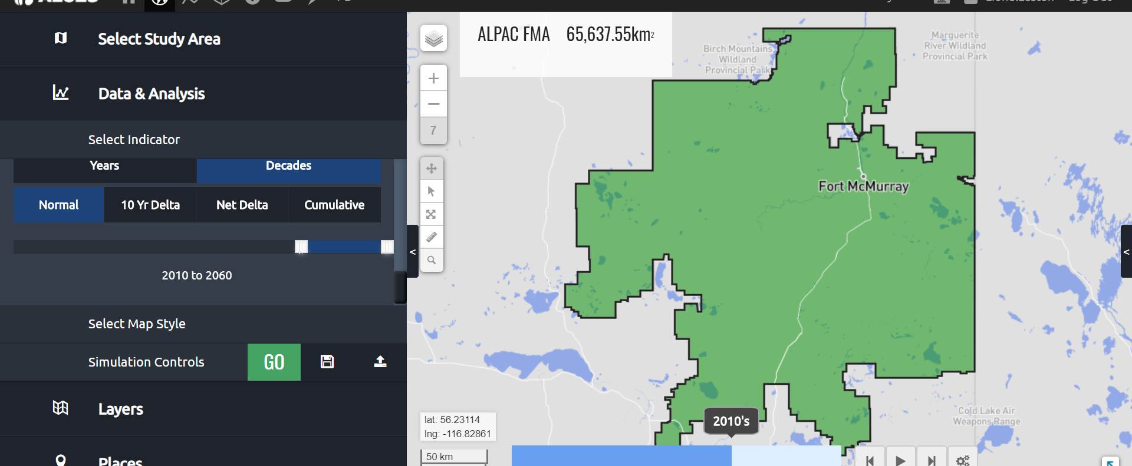
And then I pick a time period over which to run the scenario (e.g. 50 years)

Slide 17
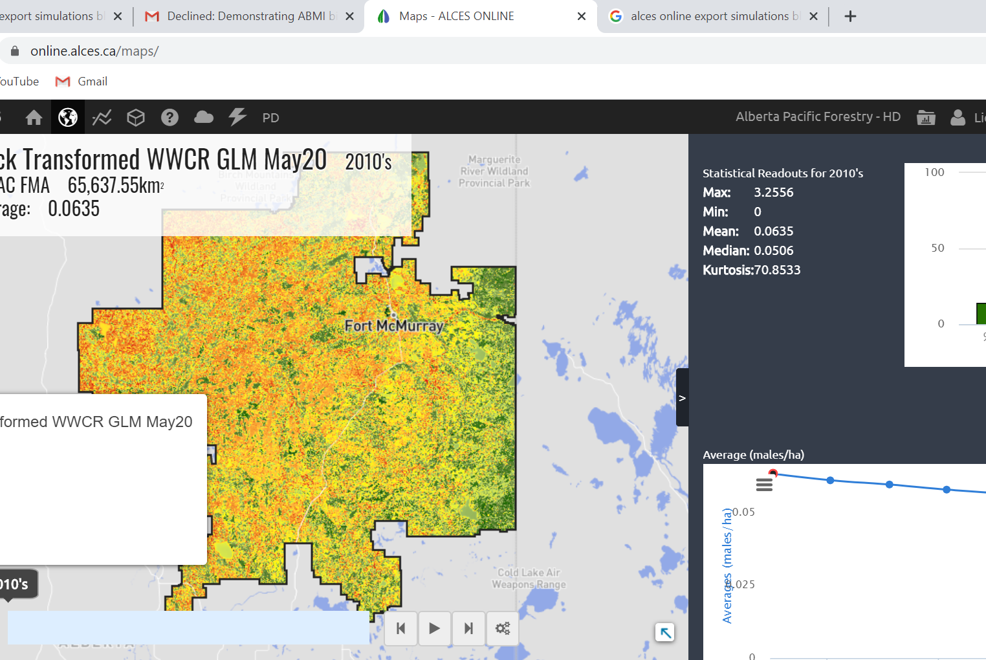
For a given scenario, species population calculated as mean density * # hectares

Slide 18
I now have projected populations for 20 species over 5 scenarios

Slide 19
Energy + No Fire
Current Fire + No Energy
Al-Pac BAU (Energy+Current Fire) + Seismic Reclamation
Al-Pac BAU (Energy+Current Fire)
Energy+2X Fire

Slide 20
Energy + No Fire
Current Fire + No Energy
Al-Pac BAU (Energy+Current Fire) + Seismic Reclamation
Al-Pac BAU (Energy+Current Fire)
Energy+2X Fire

Slide 21
Species associated with older deciduous, mixedwood or coniferous forests generally responded negatively to fire and energy sector development
*

Slide 22
Species of interest to forestry managers associated with younger forests, burns or open lands generally responded positively to fire and energy sector development
*

